Slide 1

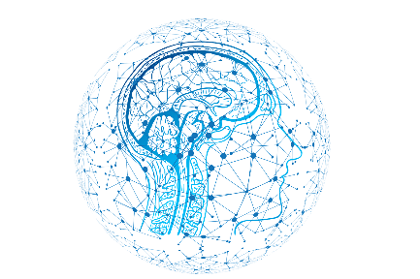
NEXT LEVEL AI
Exploring the Future of Model Optimization

Slide 2


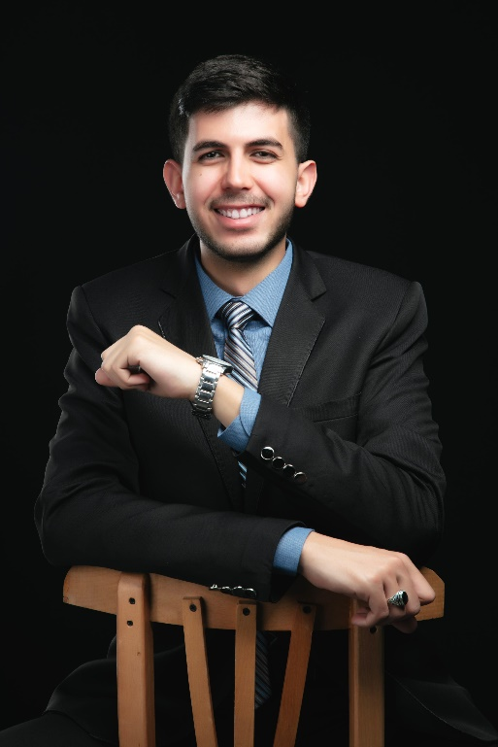
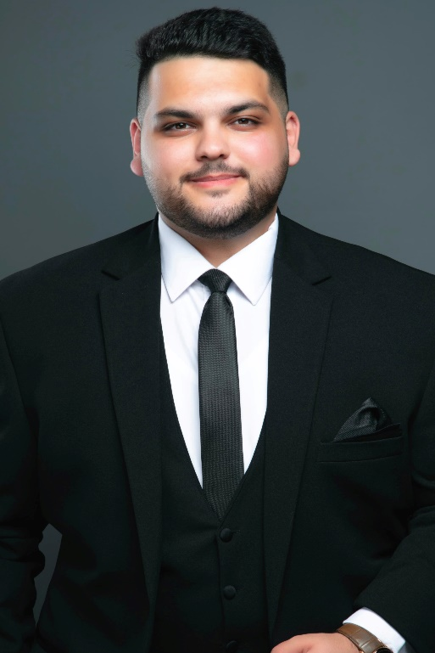
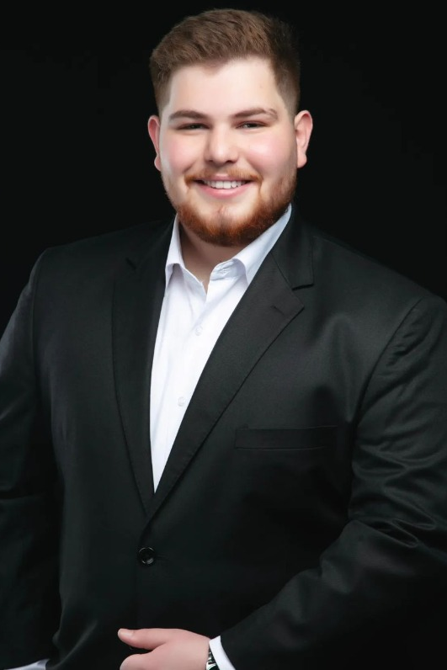
MEET THE TEAM ( COMPS )

Slide 3

What are
Foundation
Models ?
A foundation model is any model that is trained and adapted (e.g., fine-tuned) to a wide range of downstream tasks.
Foundation models are super-smart assistants that can understand and interpret languages like humans.

Slide 4
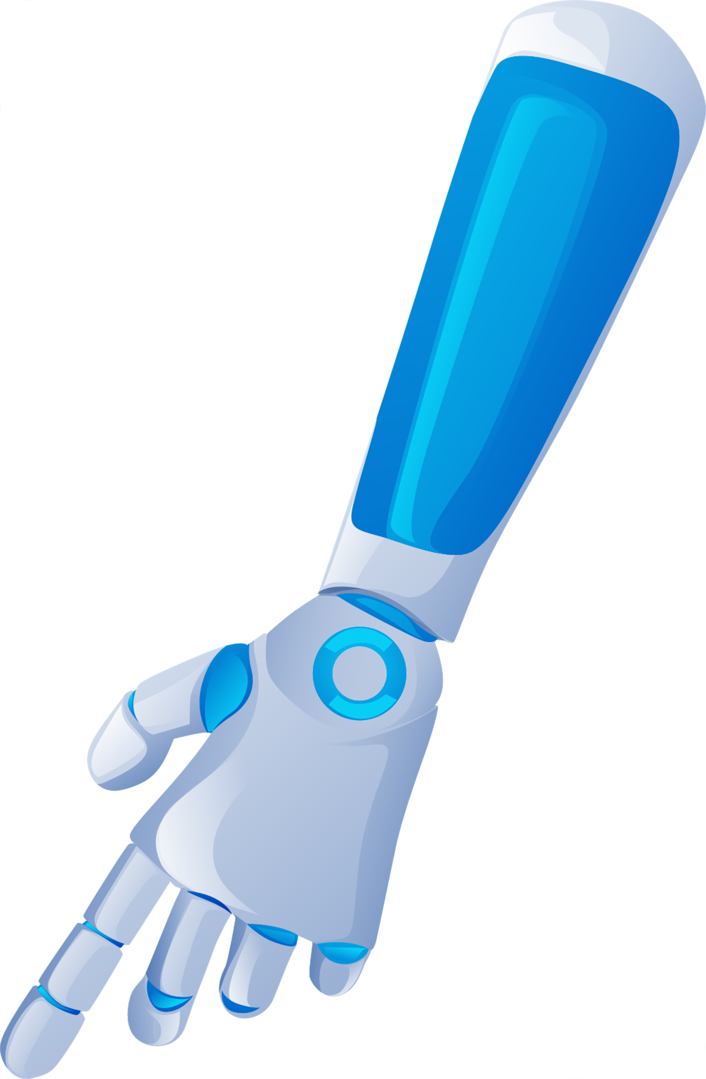

What are
Large Language Models ?
LLMs serve as foundation models but they are a fine-tuned version of foundation models.
LLMs use various techniques, including attention mechanisms, transformers, and neural networks, to process the input or a prompt and generate an output.

Slide 5




Limitations in LLM
In this slide, we'll explore the key Limitations faced by Large Language Models (LLMs) in their most basic.
Data
Accuracy of outputs
Computational power
Outdated

Slide 6

The Solutions ?

Slide 7
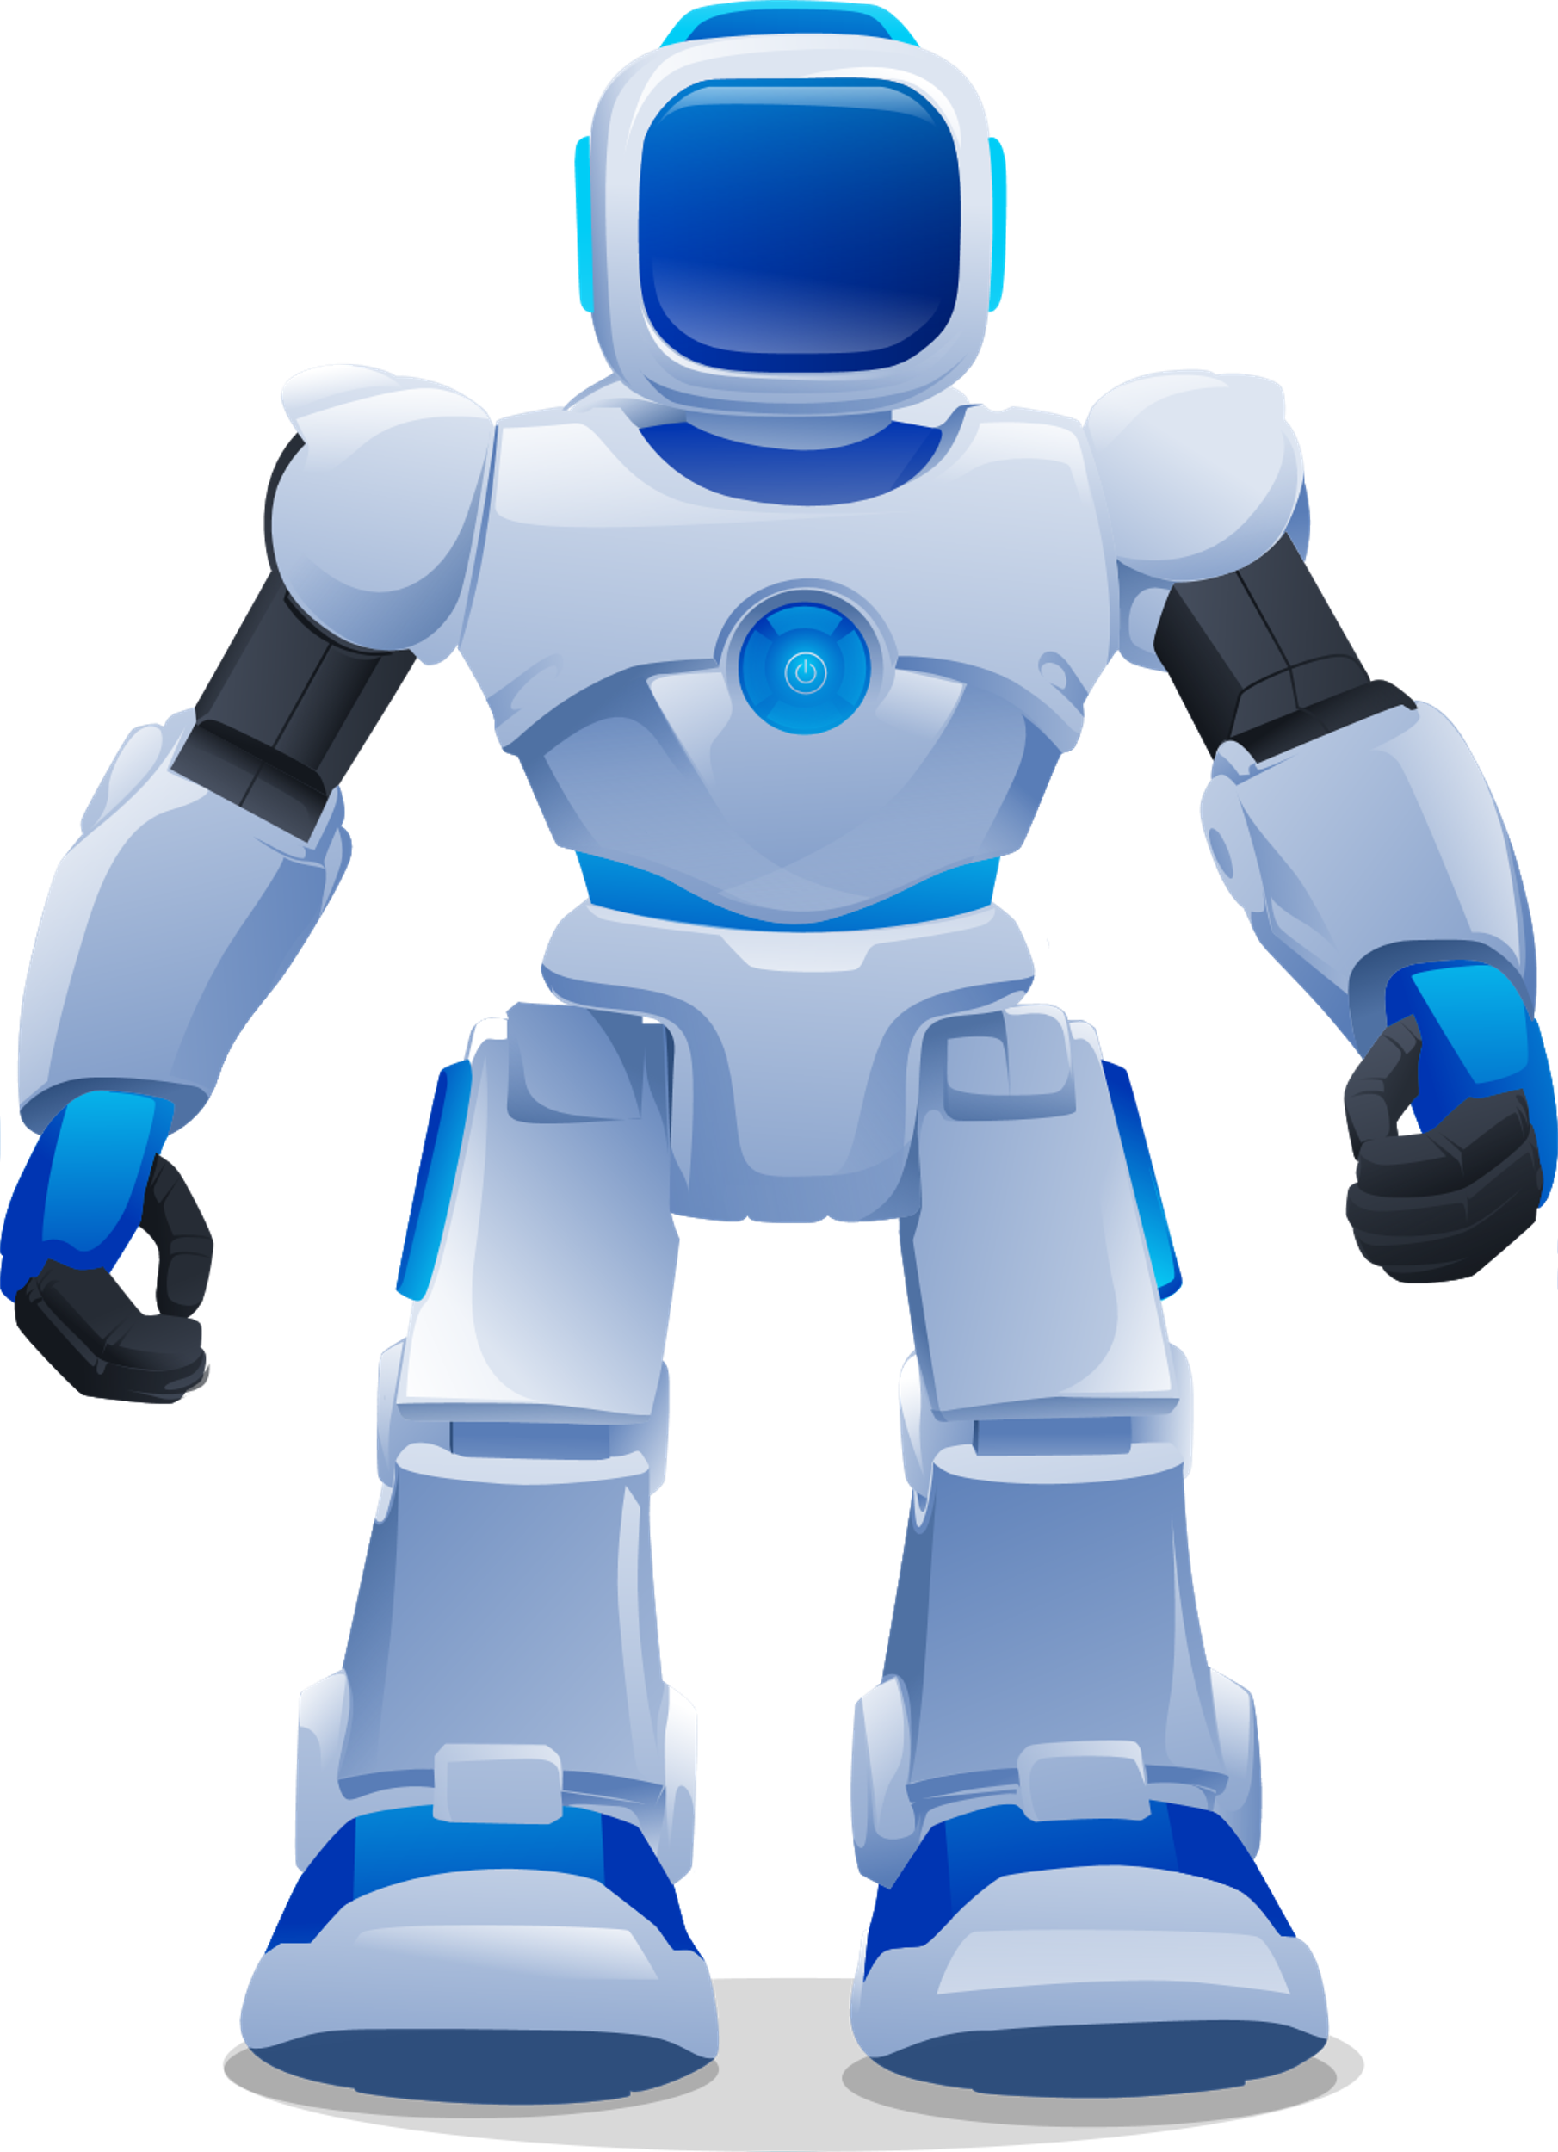
Fine Tuning
fine-tuning improves the performance of a model on specific tasks.
LLM fine-tuning is important because it allows us to make a model more useful and practical for specific applications and improve the accuracy and usefulness of the predictions and actions generated by the model.

Slide 8

PEFT Methods
Parameter Efficient Fine Tuning
LoRA
Efficiently adapts pre-trained models by updating a smaller subset of parameters, reducing computational cost and memory usage while preserving model performance.
QLoRA
Enhances LoRA by applying quantization, further minimizing resource consumption and enabling deployment on hardware with limited capabilities without sacrificing accuracy.

Slide 9

RAG
Retrieval-Augmented Generation
RAG is a way to enhance the capabilities of LLMs by combining their powerful language understanding with targeted retrieval of relevant information from external sources often with using embeddings in vector databases, leading to more accurate, trustworthy, and versatile AI-powered applications

Slide 10
Challenges
DATA
augmentation
01
03
02
04
RESOURCES
Llama2
format

Slide 11
Our achievements beyond the A+
The 2nd International Conference on Foundation and Large Language Models (FLLM2024) 26-29 November, 2024 | Dubai, UAE
01
03
02
Hugging face Dataset
Github

Slide 12

THANK YOU

